Slide 1
Building
the School
of
Tomorrow
Today

Slide 2
Focal Points
Network Infrastructure
Classroom interactive technologies
Devices
Notes:
Two Focal Points
Network infrastructure
Classroom interactive technologies

Slide 3
Funds for Technology
General Obligation Bond
Other
Instructional Materials
eRate
Federal Grant (RTT-D)
Notes:
Funds for Technology
General Obligation Bond
eRate
Federal Grants (RTT-D)

Slide 4
Internet Bandwidth: Lanes on a Highway
Highway | Bandwidth
# of Cars always exceeds capacity of highway | # of Users always exceeds capacity of available bandwidth
Non-peak Time Fewer cars can travel quicker and faster | Low Usage Time Network is faster
Rush Hour (Peak Time) More cars tie up lanes slow travel time and speed | High-processing (Peak Time) “Traffic slowdowns” grade reporting open enrollment payroll
Notes:
In this analogy, bandwidth is the number of lanes on the highway.
The number of lanes on the highway and the number of cars on the highway; no matter how wide you build the road, there will always be more cars that its capacity can handle
If you are the only car on a highway, you can travel very quickly especially during late in the evening or early morning
If you are stuck in the middle of rush hour, you may travel very slowly since all of the lanes are being used up.
The information highway can have traffic jams, just like any other. We tend to think of bandwidth as a personal right, but it’s too finite, and its limits become apparent as the highway gets more crowded.
We experience bandwidth traffic jams during any high-processing period such as grade reporting, open enrollment, and payroll
Time of day also impacts internet speed. Network is much faster between 10:00 pm and 5:00 am

Slide 5
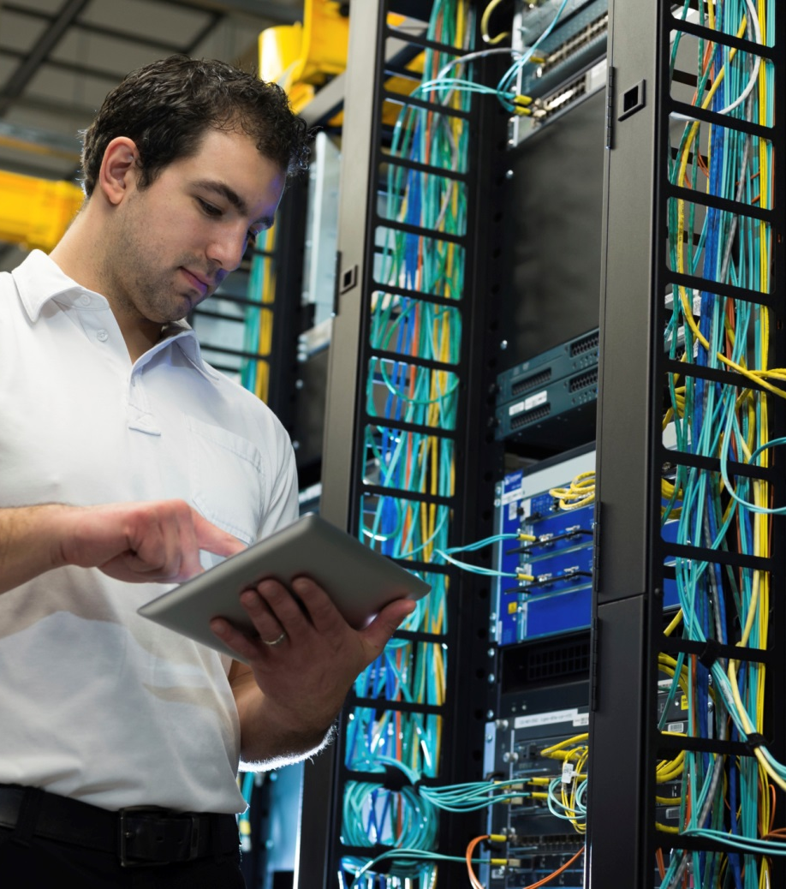
Network Infrastructure
Upgrade of district’s network backbone to support a five fold increase because of the following:
Computer based testing
Rich digital content
Virtual learning offerings
Increase in connected devices
1 to 1 initiative
Notes:
Upgrade of district’s network backbone to support a five fold increase because of the following:
Network infrastructure
Computer based testing
Rich digital content
Virtual learning offerings
Increase in connected devices
1 to 1 initiative

Slide 6
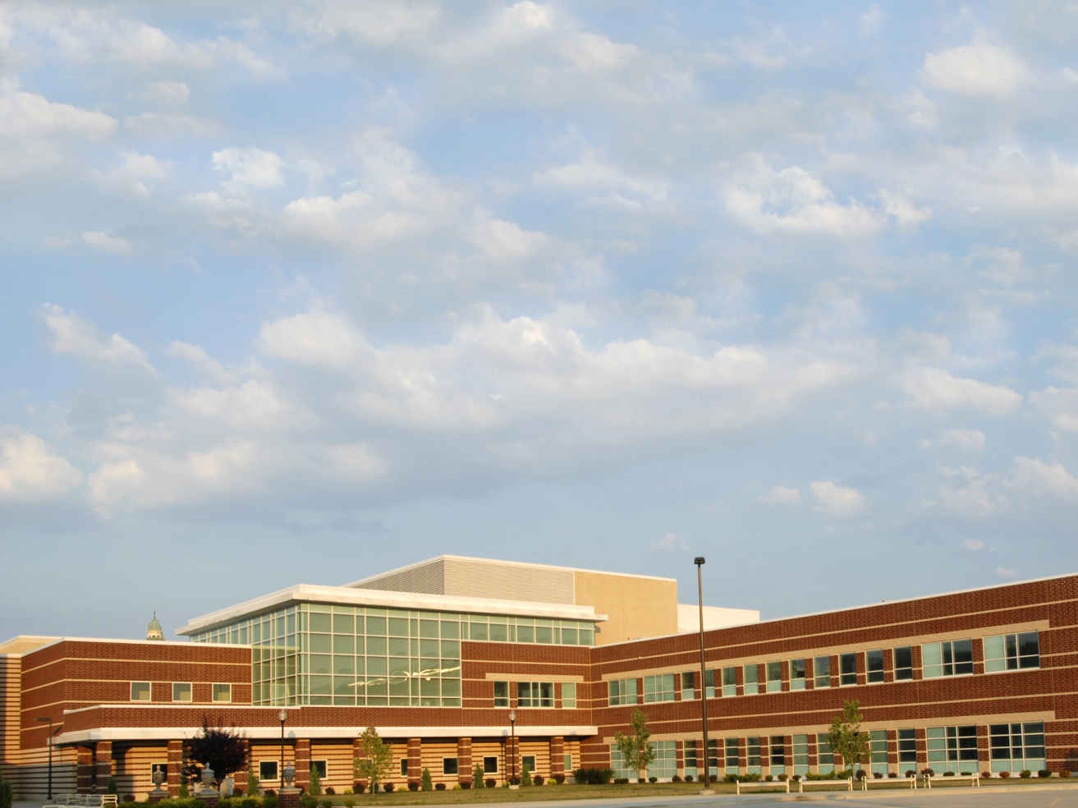
School Improvements: Typical School
Router
Tipping Point
100 Mb
100 Mb
Future School Network
Current School Network
10 Mb
10 Mb

Slide 7
School Improvements: Typical School
Backbone
Administration
10 Gb
10 Gb
Future School Network
Current School Network
1 Gb
1 Gb

Slide 8
Network Core Infrastructure Implementation Schedule
Completed in September 2013
Intrusion Prevention Devices
Increased speed for expanded portal usage
Content Filter
Increased bandwidth
age appropriate content
Traffic shaping
Internet Firewall
Increase bandwidth
2 to 4 GBPS
Coming Soon!
New Network Equipment/Services
Ethernet Switches | October 2013
Network Switches | November 2013
District Enterprise Servers
Servers | October 2013
NetApp Storage | October 2013
Increase Internet Speed Sites to ITS | March 2015
Notes:
To manage wireless infrastructure, Bring Your Own Device initiative and move to digital content the following were completed in September 2013:
Intrusion Prevention Devices
Fusion IO - Increases speed for expanded portal usage
Lightspeed Filter – Increased bandwidth & checking of age appropriate content
Procera - Traffic shaping
Cisco ASA Internet Firewall
AT&T - Increase bandwidth 2 to
Upgrade of district’s network backbone to support a five fold increase because of the following:
Network infrastructure
Computer based testing
Rich digital content
Virtual learning offerings
Increase in connected devices
1 to 1 initiative
Coming Soon!
Cisco Ethernet Switches – October 2013
Core Network Switches – November 2013
District Enterprise Servers
HP Blades – October 2013
NetApp Storage – October 2013
AT&T Switched Ethernet (ASE) – Increase internet speed sites to ITS - March 2015

Slide 9
What is Changing!
SBAB
ITS Computer Center
Internet
Large Schools
Ethernet
Small to Medium Schools

Slide 10
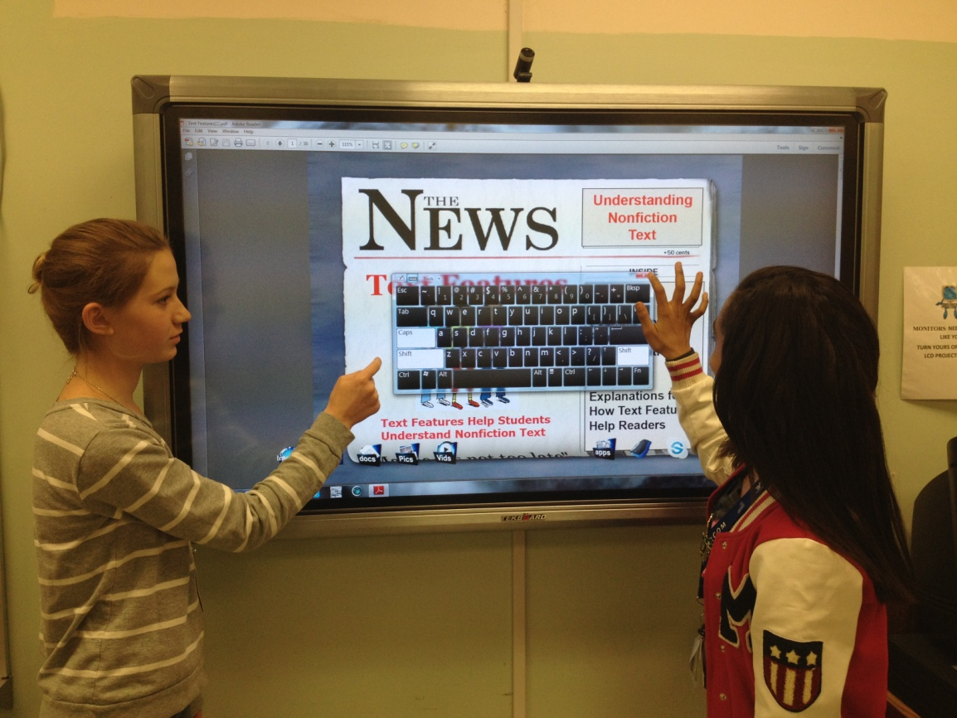
Action Steps
Survey of current interactive technologies
Accommodate devices currently used in schools
Investigate new technologies to accommodate blended learning
Interactive and infrastructure upgrades completed by July 2015
Mobile Device RFI
Ensure dependencies between mobile devices and new projection systems
Classroom Interactive Technologies
34
Notes:
Classroom Interactive Technologies
Action Steps
Survey of current interactive technologies
Accommodate devices currently used in schools
Investigate new technologies to accommodate blended learning
Interactive technologies and infrastructure upgrades completed by July 2015

Slide 11
Infrastructure Implementations Schedule
School Improvements
2012-2013 |  |  |  |  | 2013-2014
 | Wireless | Infrastructure | Interactive Devices | PBX | Wireless | Infrastructure | Interactive Devices | PBX
Elementary | 137 | 0 |  | 82 | 202 | 132 |  | 173
K-8 Centers | 18 | 0 |  | 10 | 37 | 16 |  | 35
Middle | 34 | 0 |  | 15 | 62 | 40 |  | 51
High Schools | 30 | 0 |  | 1 | 11 | 14 |  | 45

Slide 12
21st Century Schools Technology Upgrade Project Cost Estimates
Information Technology Upgrades ………………………………… SAN Server Upgrade Content Filter | $4,000,000
School Upgrades……………………………………………………….. Infrastructure Upgrade ………………………………………........ E-Rate Match FY-13-14 (10% & Ineligible items) ……………. Interactive Devices ……………………………………................ | $82,000,000 $38,000,000 $6,000,000 $38,000,000
School Upgrades Non-Bond Funded Computers……………………………………………………........ | $63,450,000
NOTES $46M total request for e-rate year 16 $24.5M to complete infrastructure if 90% schools are funded
Notes:
$12.5M to complete wireless

Slide 13
Going Wireless: What You Need to Know
What Is a Wireless Network?
A wireless local-area network (LAN) uses radio waves to connect devices such as laptops to the Internet and to our district business network and its applications.
When students, staff, or visitors connect a laptop to a Wi-Fi hotspot at a school they are connecting to that school's wireless network.
What Is a Wireless Network? Catching Up with Wired Networks
Some may believe wired networks are faster and more secure than wireless networks.
Continual enhancements to wireless networking standards and technologies have eroded those speed and security differences.
Notes:
$12.5M to complete wireless

Slide 14
Our Wireless Project – Largest in the US!
MDCPS
370,000+ Students
23,000+ Teachers
350+ Schools
11,000 Access Points & 270 Controllers
By Spring 2014, 17,700+ Access Points & 400+ Controllers to be deployed
Philadelphia , PA Public Schools
175,000+ Students
11,000+ Teachers
200 Schools
Installed: 16,600 Access Points & 280 Controllers
Clark County, NV Public Schools
318,000+ Students
15,000+ Teachers
370 Schools: 140 schools deployed
4,800 Access Points & 100 Controllers
Once fully deployed: Additional 190 Controllers, 10,000 Access Points
Notes:
$12.5M to complete wireless

Slide 15
Success or Failure – We Are in Control
Bandwidth Management → Planning for the demand on the network
Class Management → LanSchool, Carnegie Learning, On-Line Educational Videos
Social Etiquette → WiFi Best Practices for IT, Admin, Student/Guest
Content Management → Radius, Firewalls, Web filtering, ….
From here forward, success will be more about behavior and expectation management, and less about the technology. ITS must manage this cultural shift—will take time and effort.
Notes:
$12.5M to complete wireless

Slide 16
Going Wireless: Benefits
Convenience
Access the district network resources from any location within the particular wireless network's coverage area or from any Wi-Fi hotspot.
Mobility
Users are no longer tied to their desk, as they were with a wired connection. Students and staff can go online in conference room meetings, for example.
Notes:
$12.5M to complete wireless

Slide 17
Going Wireless: Benefits
Productivity
Wireless access to the Internet and to the district’s key applications and resources helps students and staff get the job done and encourages collaboration.
Security
Advances in wireless networks provide robust security protections.
Notes:
$12.5M to complete wireless

Slide 18
Going Wireless: Benefits
Increased mobility and collaboration
Roam without losing the connection
Work together more effectively. Everyone in a team meeting or in small conferences having access to up-to-the minute communications, and all documents and applications.
Better access to information
Wireless LANs will allow a school or office to bring network access to areas that would be difficult to connect to a wired network. For examples, temporary portable classrooms or trailers.
Notes:
$12.5M to complete wireless

Slide 19
Going Wireless: Benefits
Easier network expansion
New students or staff or if offices are reconfigured will immediately benefit from a wireless LANs. Desks can be moved and new students and or staff can be added to the network without the effort and cost required to run cables and wires.
Enhanced guest access
Give secure network access to the public and in some cases business partners
Notes:
$12.5M to complete wireless

Slide 20
Going Wireless: Are We Ready?
Make Sure PCs or Laptops Are Wireless
Most laptops today have built-in wireless networking connections.
Get a Router Capable of Wireless Networking
Routers today act as wireless networking access points. They let you connect multiple computers to a single wireless network. And they connect your network to the Internet.
Notes:
$12.5M to complete wireless

Slide 21
Going Wireless: Are We ready?
Install Access Points
Additional access points extend the wireless signal's range and strength over a wider geographical area, so that it's available in more places, such as conference rooms.
The signal from each wireless access point extends up to approximately 300 feet and gets weaker the longer it has to travel. Walls, metal (such as in elevator shafts) and floors can negatively affect range.
Secure The Network
Data encryption, so only authorized users can access information over wireless network.
User authentication, which identifies computers trying to access the network.
Secure access for visitors and guests.
Control systems, which protect the laptops and other devices that use the network.
Notes:
$12.5M to complete wireless

Slide 22
Going Wireless: Things to Consider
Do not connect to the wireless network if the Internet is not needed!
Don't Overshare Access Points
Don't share any single wireless access point with more than 20 users.
The more users sharing an access point, the slower the wireless network can become.
Notes:
$12.5M to complete wireless

Slide 23
Going Wireless: Things to Consider
Charge up
Minimizing your need for external power.
An extra battery is also a good idea.
Don’t Hog Bandwidth
Keep the downloads to a minimum. Large file downloads when there’s a large group of users sharing bandwidth is a no-no.
Notes:
$12.5M to complete wireless

Slide 24
Going Wireless: Things to Consider
Guests
Should use the wireless guest account and the “password of the day.”
Guests should have a signed AUP agreement on file.
Personal devices should NOT be hard-wired to the network; only wireless access is permitted.
Notes:
$12.5M to complete wireless

Slide 25
Going Wireless: Before You Start
Bring Your Own Technology is a program which allows students and staff to use their own technology during their school or work.
Notes:
$12.5M to complete wireless

Slide 26
Going Wireless: Before You Start
Parent Permission:
PERSONALLY OWNED COMPUTING/NETWORK DEVICE ACCEPTANCE OF RESPONSIBILITY AND DEVICE USE AGREEMENT PERMISSION FORM
I______________( Name of parent or guardian), agree to let______________(Name of student)
To bring their personally owned computing device for instructional use at_________________(Name of school) (MDCPS). I understand that the student named above will be permitted to use their personally owned device, subject to the conditions in this document.
I understand that if I agree to allow my student to use their own device that Miami Dade County Public Schools or the school is not responsible for any device or data loss, theft, damage or other associated costs of replacement or repair incurred during the school day or at home as a result of participation in this program. I understand that MDCPS Staff will be unable to store, support or troubleshoot student owned devices. The student named above will take full responsibility for the device and will appropriately secure all devices when not in use.
MDCPS uses technological measures such as filtering to promote internet safety. Filtering limits students’ ability to access harmful internet sites from any device connected to the MDCPS network, but only when this equipment is used in school on the MDCPS network. Access through cellular networks does not provide the same measures of filtering. Students should only use the MDCPS network (not private cellular service) for internet access while on MDCPS property.
I have verified my student is aware that all aspects of the Miami Dade County Public School’s Student Rights and Responsibilities, Acceptable Use Policy for Network Access apply to the use and care of their personal device while on MDCPS property or while involved in any MDCPS sponsored event/activity.
I understand that the purpose of allowing my student to use their own device is to participate in teacher approved activities in support of the MDCPS curriculum. Uses of these devices for unrelated activities beyond or outside the MDCPS educational program are prohibited.
____________________________________
___/___/___
Parent or Guardian’s Signature
Date
Notes:
$12.5M to complete wireless

Slide 27
Going Wireless: Before You Start
Student Acceptance:
I agree to adhere to the AUP guidelines presented in the Student Rights and Responsibilities Booklet. I will utilize the device(s) for instructional purposes only while at any MDCPS school or on the MDCPS network.
____________________________________
___/___/___
Student Signature
Student ID#
Date
Notes:
$12.5M to complete wireless

Slide 28
Building
the School
of
Tomorrow
Today

